Slide 1


Design and Analysis of Data Structures and Algorithms
Presentation by
Lyernisha S R

Slide 2
Algorithm and Analysis

Slide 3
Analysing algorithms
Correctness
Algorithmic efficiency
Rates of growth
Best, worst and average case behaviours
Big-O

Slide 4
Analysis of algorithms
Analysis of algorithms can be in terms that
are:
Qualitative - informal
Quantitative - formal

Slide 5
Qualitative perspectives – what are good algorithms?
1. Economical with computing and human resources
2. Simple but powerful and effective solutions to problems that also have generality of applicability
3. Easy to comprehend by others – clear and concise structure; no unnecessary complexity or obfuscation
4. Easily modifiable – enabled by being well-documented, concise, readable, and easy to understand. But this is a lot to ask…
5. They pass verifiability and correctness measures – does the algorithm do what it’s supposed to do?
6. They are well documented using objective standards in a way to enable efficient comprehension
7. Platform Independent- (machine/language) Not dependent
8. They should display sufficient modularity or encapsulation to be used as a subroutine for a nother program
9. The solution should ideally be a pleasing solution for the programmer and display elegance in design
10. They should avoid structural redundancy

Slide 6
Quantitative perspectives:
More precisely predictive regarding algorithmic performance
Mathematical techniques and/or formal proofs employed to measure and compare performance and computational complexity
Methods used depend on developer intent.

Slide 7
Analysing algorithms:
There are many different ways to analyse algorithms.
Different methods offer different levels of formality.
The method used will depend on what the programmer seeks to determine.
Analysing is done with a view to improving them.
Space and time issues.

Slide 8
Why and from what perspectives do we analyse algorithms?
What are the fundamental criteria or comparisons that are used to choose among competing algorithms?
What types of measure can we employ?
How do we evaluate the performance and efficiency of an algorithm?
Why do we want to do this?

Slide 9
Options to analyse algorithms
1. Correctness – does the algorithm do what it is supposed to do?
2. Amount of space used – less important today but may still impact on performance on local levels
3. Simplicity and clarity – is the algorithm efficient and easy to understand?
4. Efficiency
5. Running time
6. Primitive operations
7. Big-O
8.Amount of work done – how is computational effort measured; what techniques can we employ to do this; is execution time a good measure; if not, why not; time is a weak form of comparison as it is insufficiently abstract and general; growth rate a more important and powerful measure

Slide 10
1. Correctness:
Different types of correctness to consider:
Errors
Induction
Assertions
Termination

Slide 11
a) Correctness - Errors
Most programs contain errors – or bugs
Even programs that have been used ‘successfully’ for long periods of time
In this case, it may be that only exceptional circumstances or rare input trigger the error
Errors exist because algorithms are fundamentally complex – need creativity to design and are often hard to understand by those other than the author

Slide 12
How to produce error-free programs?
Two approaches:
1. Testing: the process of testing the program on test data. This is limited to testing the program on a particular selection or sub-section of data, not all data. Here, behaviour in a limited sense is examined.
2. Proving: this is more thorough, as here the program is proven to be correct by testing it on all permissible input data. Here OVERALL behaviour is examined. Aim is to obtain 100% confidence in an algorithm’s design and structure.
Highly formalised and complete proofs are necessary in cases where program performance is critical (health monitoring equipment).
But for most applications, differing levels of informal proofs are adequate.
Informal proofs:
Documentation: written record of what the program does and/or
should do; how the program works
Desk-checking: reading through and fully understanding the
program written

Slide 13
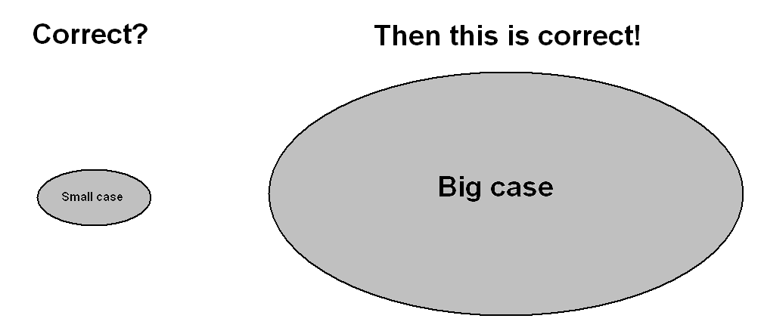
b)Correctness - Induction:
A frequently used method in proofs of correctness for ‘short’ routines, or single module algorithms where the complexity can be perceived relatively easily.
This is used when we need to determine that a statement or routine is true in all circumstances.
The method involves proving correctness for a small, limited, or particular case. By induction, it is then shown to be true for all or larger cases.
It then follows that the proof is valid in all cases.

Slide 14
c)Correctness – Assertions:
Preconditions and post conditions:
This approach is used for larger algorithms comprising multiple modules or classes that reference each other.
Larger programs are frequently more difficult to analyse and comprehend.
Idea is to use methods of induction on each module to determine that all modules working in collaboration are proved correct.

Slide 15
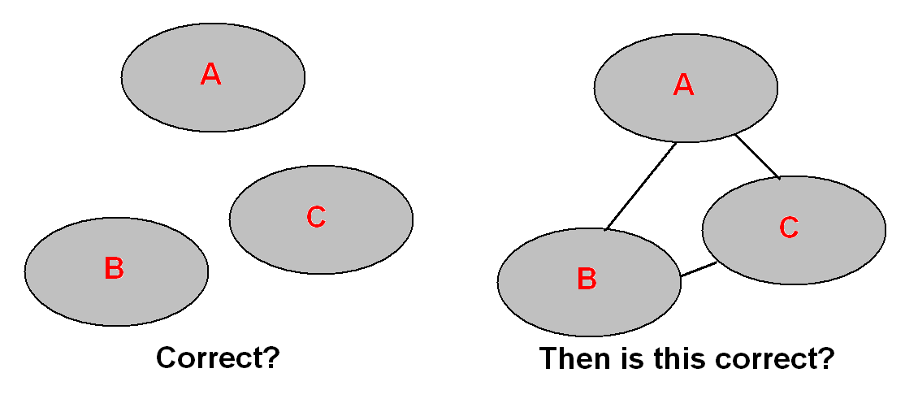
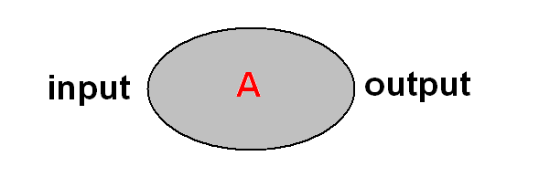
c)Correctness – Assertions:
Assumption here is that, if modules A, B, and C are correct, then their interaction, correctly specified, will also be correct.
Such proofs involve verifying the correctness of inputs to the module and the corresponding outputs:

Slide 16
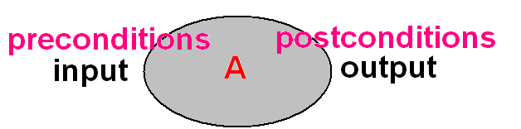
c)Correctness – Assertions:
Specifying module behaviour in these terms comprises TWO parts:
Pre-conditions: Specifying the range of inputs upon which the module or object is going to operate. The state of the module before the module processes input
Post-conditions: Specifying the effects such inputs have on the module or object. The state of the module after the module has processed the input.
Pre- and post-conditions are known as:
ASSERTIONS
since they assert the truth of some condition, or the validity and/or correctness of the input, processing and output conditions.

Slide 17
d)Correctness - Termination:
Algorithms can be PARTIALLY CORRECT if confidence obtained regarding integrity of output.
But the TOTAL correctness of an algorithm depends on termination.

Slide 18
To determine total correctness, TERMINATION PROOFS are established using TERMINATION ANALYSIS.
To prove a program terminates:
Show that it accomplishes stated objective in a FINITE number of steps
Usually necessary to verify that EVERY loop in the program TERMINATES in a finite number of steps
Usually, PROOF OF TERMINATION follows directly from the nature of the iterative constructs themselves.

Slide 19
For example:
In the following, when n is positive the loop is guaranteed to terminate, as with each ITERATION the steps to termination are reduced by one:
for i:= 1 to n do
begin
.
.
.
end
But sometimes the proof of termination is less clear cut.
In this case there are two options:
1. When there is more than 1 variable controlling the termination condition,
we need to track the cumulative progress of both with each iteration
2. Otherwise, we need to use and/or seek the presence of a SENTINEL
value or some other data property that FORCES termination
But proving termination is NOT always possible.

Slide 20
2.Amount of space used:
A less important issue today, but not irrelevant.

Slide 21
3.Simplicity and clarity:
Raises both qualitative and quantitative questions and issues that can also be discussed in term of efficiency.
Issues:
clarity of expression and structure
easily comprehendible by others
easily maintainable
Programmers often speak of design elegance.

Slide 22
4. Efficiency of algorithms:
Can be determined with reference to:
a. Redundant computations – wasted effort
b. Referencing array elements
c. Inefficiency due to late termination – wasted effort
d. Exit conditions not detected – wasted effort

Slide 23
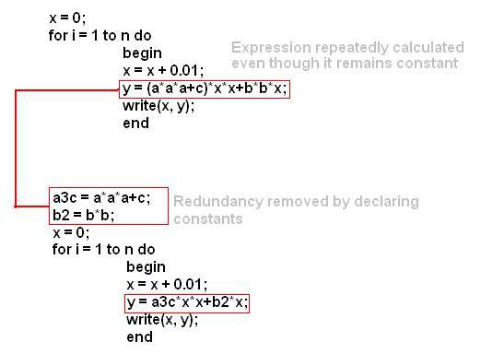
a) Redundant computations:
Don’t include instructions that are redundant
Results in use of unnecessary data storage and memory
The savings here are trivial, but the principle is very important in more complex situations.

Slide 24
b)Inefficiency due to late termination:
This occurs when more tests are executed on data than is required.
Take a linear search for a name
An inefficient search routine would continue to search an array even when a value has been found - this means the target could not exist further in the list

Slide 25
c) Exit conditions not detected
Results in wasted effort and computation.

Slide 26
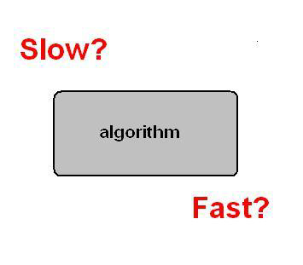
5. Running Time of algorithms:
This is a natural way to measure performance.

Slide 27
Analysing time complexity:
Many factors influence running time:
1. Simple or multi-processor hardware
2. Read or write speed
3. 32 or 64 bit architecture
4. Program input
Factors 1-3 generally ignored.
Rather, we ask:
How does our program behave/perform with various input sizes?
How does the time taken to run a program grow with input size?
What is the rate of growth with respect to input size?
Posing and answering these questions, we implicitly define a model of an ‘abstract’ machine:
1. Simple processor
2. 32 bit
3. Sequential execution
4. Takes 1 UNIT OF TIME to perform various programming actions such as mathematical and logical operations, assignments, function return calls, etc

Slide 28
How can we measure it?
Measure an algorithm on various test inputs and record the actual operation time.
Do this by inserting functions to inform us of performance such as System.currentTimeMillis() method in Java.
In general, however, INPUT SIZE will have the BIGGEST effect on running time.
This being the case, run tests with different input sizes

Slide 29
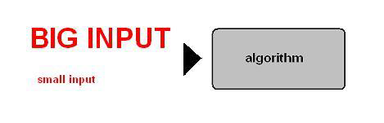
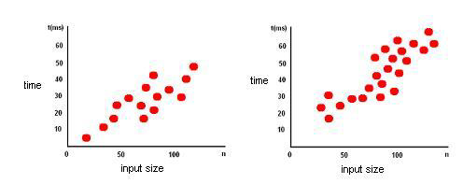
This can be visualized as points on a graph showing how input size affects execution time.
In general, running time increases with input size.

Slide 30
Disadvantages of statistical data from experiments on running times:
Experiments can only be done on a limited set of inputs and may be
unrepresentative – not all input conditions can be modelled
It is difficult to compare two algorithms unless they run on the same
hardware and software environment
An algorithm must be fully implemented in order to study its running time
experimentally
A more general methodology needs to be in place that is:
Hardware and software independent
Takes into account all types of input
Capable of offering an analysis that is not dependent on implementing
algorithms or running actual experiments – pseudo code effective as high
level descriptions that combine natural language and programming code
segments, avoiding implementational detail

Slide 31
6. Primitive Operations:
This approach to analysis is performed directly with reference to high-level pseudo code that lists the:
primitive operations
performed by the algorithm.
These are generally independent of a programming language.
Primitive operations are low-level instructions with execution times dependent on hardware and software environments, but nevertheless constant.
Primitive operations include:
Assigning a value to a variable
Calling a routine, function, or method
Performing an arithmetic operation
Comparing two numbers
Indexing into an array
Following an object or data item reference
Returning a parameter call in a function or method
Rather than calculating the actual execution time, in this method we count the number of
primitive operations.
This value becomes a high level estimate of execution and running time.
•

Slide 32
Example
x = 5 * a + 6 * b
except that in execution there are:
2 multiplications
1 addition
1 assignment
Each is a primitive statement and each represents 1 UNIT OF TIME
Definition depends on the level of detail you are seeking
Each operation or programming step has a COST and contributes toward the overall TIME COMPLEXITY
Each COST has a FREQUENCY

Slide 33
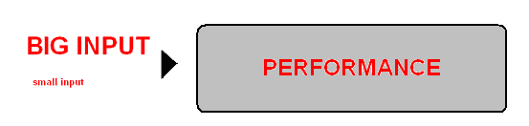
7.Rates of growth
Generally, the number of operations that an algorithm executes is not the most important measure of an algorithm’s performance.
More important is how is the
performance
of an algorithm is affected as the size of the problem increases
How, for example, does the cost of solving a problem vary as the size of n – the input – increases?

Slide 34
We might say, as n increases, computational cost increases in direct relation: by this measure an input of n = 200 will take twice the amount of time as n = 100.
This is a simple:
linear
dependency.
This is frequently the case in simple algorithms.
But in general, as n increases so does computational complexity which affects performance.

Slide 35
8.Big O notation
Big O notation is used to classify algorithms according to how their run time or space requirements grow as the input size grows
Big O notation characterizes functions according to their growth rates: different functions with the same growth rate may be represented using the same O notation.
The letter O is used because the growth rate of a function is also referred to as the order of the function.
It is useful in the analysis of algorithms

Slide 36
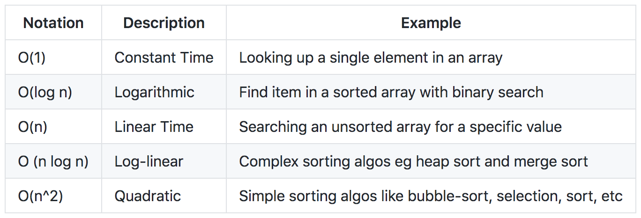
Few Big O notations

Slide 37
Why and from what perspectives do we analyse algorithms?
What are the fundamental criteria or comparisons that are used to choose among competing algorithms? What types of measure can we employ? How do we evaluate the performance and efficiency of an algorithm? Why do we want to do this?
Part 1:
1. Correctness – does the algorithm do what it is supposed to do?
2. Amount of space used – less important today but may still impact on performance on local levels
3. Simplicity and clarity – is the algorithm efficient and easy to understand?
4. Efficiency
5. Running time
6. Primitive operations
7. Big-0
8. Amount of work done

Slide 38
Thank you!

